Slide 1

Image Quality Assessment
Wang Yan

Slide 2
CONTENTS
Introduction
Index
Method

Slide 3
Introduction
Index
Method
What is IQA
Fidelity
The distortion level between the test and reference image in the process of observation of the human eye.
Intelligibility
The ability of the test image on providing information for human/machine consumers with respect to the reference image.
Notes:
图像的逼真度是描述评价图像与标准图像的偏离程度；而图像的可懂度则是表示图像能向人和机器提供信息的能力。 图像质量评价比较困难，一般现在用均方误差表示客观逼真度，而图像的可懂度定量测量还很困难。

Slide 4
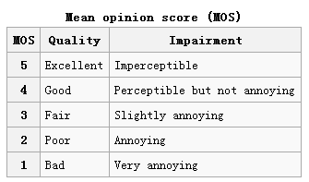
Introduction
Index
Method
Subjective IQA
HVS(Human visual system)
MOS(Mean opinion score)
DOMS(Differential mean opinion score)
Notes:
Mos越大质量越高 相反 doms越小质量越高

Slide 5
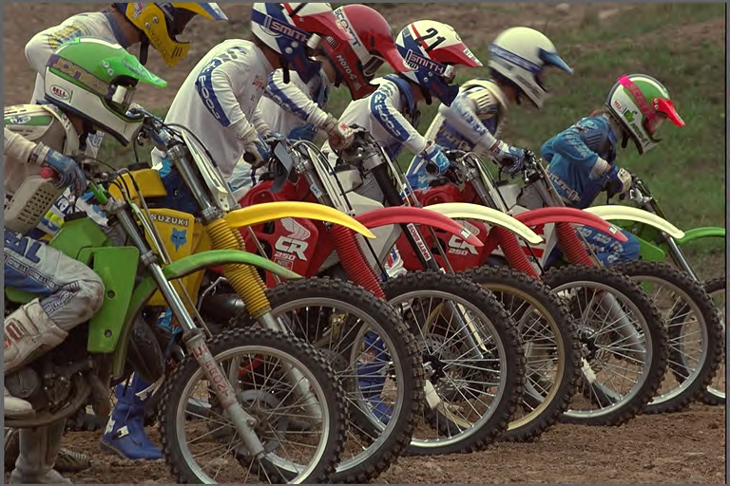
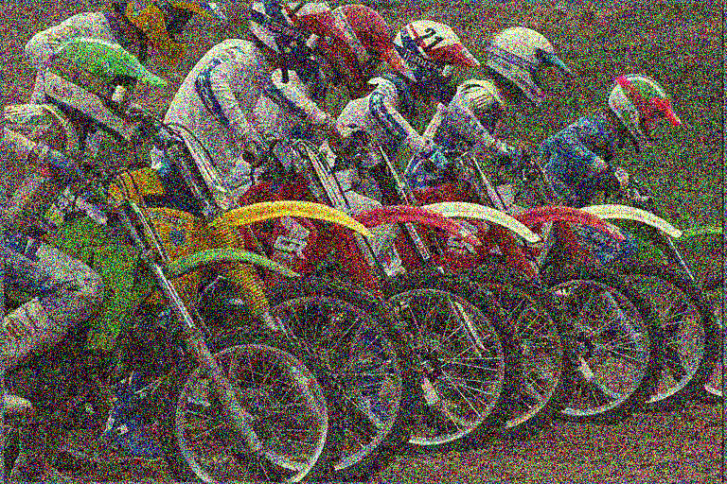
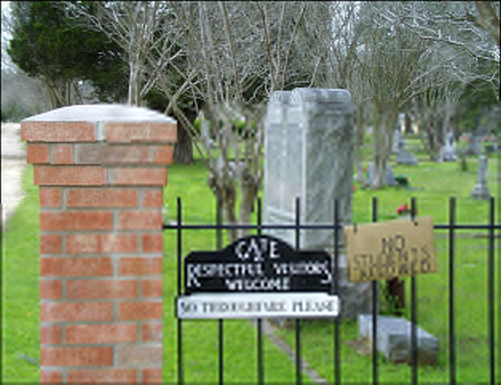
Introduction
Index
Method
Objective IQA

Slide 6
Introduction
Index
Method
Objective IQA
Full reference IQA (FR-IQA)
Reduce reference IQA (RR-IQA)
No reference IQA (NR-IQA)
Notes:
根据评价时是否需要参考图像----全参考客观图像质量评价方法是指把原始参考图像与失真图像在每一个对应帧中的每一个对应像素之问进行比较。准确的讲，这种方法得到的并不是真正的图像质量，而是失真图像相对于原始图像的相似程度或保真程度

Slide 7
Introduction
Index
Method
Distortion type
Fast fading
Gauss blur
JPEG
JPEG2000
White noise

Slide 8
Introduction
Index
Method
Database
LIVE
TID2008/2013
CSIQ
IVC

Slide 9
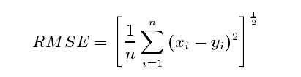
Introduction
Index
Method
RMSE (Root mean squared error)
RMSE can compare the absolute error between MOS(DOMS) and scores given by a certain algorithm. It shows the accuracy of an algorithm.
Notes:
图像质量评价算法又很多，算法都各有特点，但评价效果好坏需要衡量标准。【均方根误差】通常以算法评价值和人眼主观打分值的误差和相关性来进行评价.

Slide 10
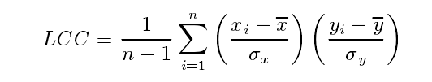
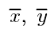
Introduction
Index
Method
LCC (Linear correlation coefficient)
PLCC (Pearson LCC)
are the standard deviation of MOS and scores give by a certain algorithm.LCC(PLCC) describes the correlation between the two scores. It also show the accuracy of an algorithm.
Notes:
线性相关系数 or 皮尔逊线性相关系数

Slide 11
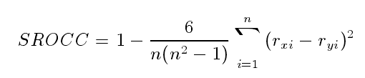
Introduction
Index
Method
SROCC (Spearman’s rank ordered
correlation coefficient)
It predicts the monotonicity of an algorithm.
Notes:
Spearman秩相关系数 ，rx ry为x y在各自数据序列中的排序位置

Slide 12
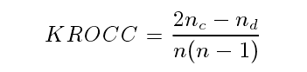
Introduction
Index
Method
KROCC (Kendall rank order
correlation coefficient)
It also predicts the monotonicity of an algorithm.
PLCC 为 Pearson 相关系数，
SROCC为 Spearman相关系数，
KROCC 为 Kendall 相关系数。
相关系数的值越接近于1，表明算法越准确。
Notes:
Nc是数据集中的一直对个数，Nd是不一直对个数

Slide 13
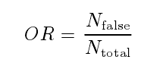
Introduction
Index
Method
OR (Outlier ratio)
It can evaluate the consistency of the result based on an certain algorithm.
Notes:
离出率表示超出主观得分正负2倍标准差的 样本数 百分比 其中N false是超出的，Ntotal是总样本书，高斯分布情况下，2倍标准差包含了95%的样本数

Slide 14
Introduction
Index
Method
FR-IQA
SSIM
PSNR
NR-IQA
JNB
DA-IQA
CPBD
LPC
NIQE
CBIQ
IL-NIQE
DU-IQA
DU-OU-IQA
DU-UA-IQA
BRISQUE
ROBUST
SSEQ

Slide 15
Introduction
Index
Method
SSIM
Structural Similarity
基于结构相似度的全参考图像质量评价
Idea: Under the assumption that human visual(HSV) perception is highly adapted for extracting structural information from a scene. we introduce an alternative framework or quality assessment based on the degradation of structural information
首先,结构信息不应该受到亮度的影响，因此在计算结构信息时需要去掉亮度信息，即减掉图像的均值；其次,结构信息不应该受到图像对比度的影响，因此计算结构信息时，需要归一化图像的方差。结构相似度指数从图像的组成角度将结构信息定义为独立于亮度、对比度的，反应场景中物体结构的属性。并将失真建模为亮度、对比度和结构三个不同因素的组合。用均值作为亮度的估计，标准差作为对比度的估计，协方差作为结构相似性的度量。

Slide 16
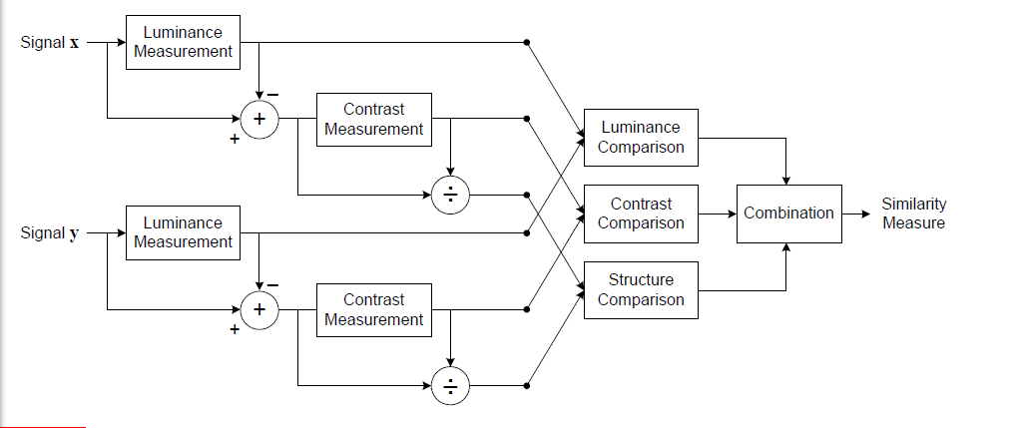
Introduction
Index
Method
SSIM

Slide 17
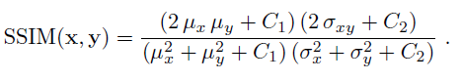
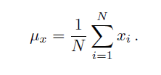
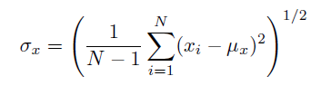
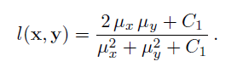
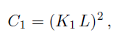
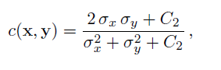
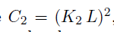
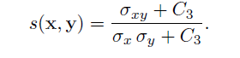
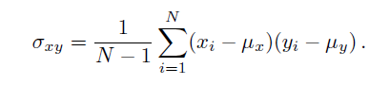
Introduction
Index
Method
SSIM
mean intensity (used to estimate luminance):
standard deviation(used to estimate contrast):
Luminance comparison
L=255( is the dynamic range of the pixel values)
K1=0.01
Contrast comparison
Structure comparison
C3=C2/2

Slide 18

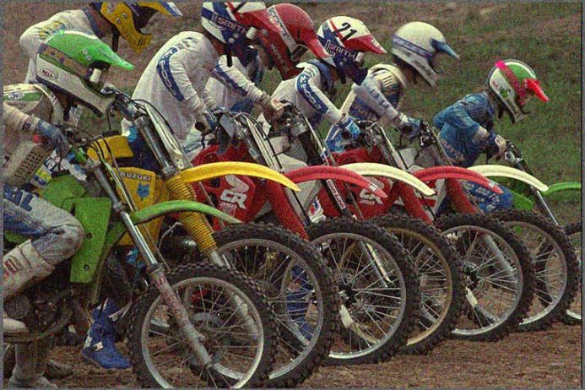

Introduction
Index
Method
SSIM
Simulation results (Matlab)
SSIM（1&2）=0.6764
SSIM（1&3）=0.2583

Slide 19
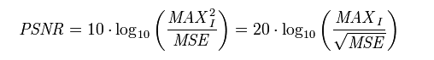
Introduction
Index
Method
PSNR
Peak Signal Noise Ratio 峰值信噪比
Output：PSNR index
均方根误差MSE; MAX通常是图像的灰度级，一般是255
PSNR以dB为单位，PSNR值越大表示图像失真越小。PSNR是最广泛使用的评价画质的客观测量法，但是实际检测结果显示，PSNR的评价结果无法与人眼看到的视觉品质完全一致，有可能PSNR较高者反而比PSNR较低者看起来差。这是因为人眼的视觉对误差的敏感度并不是绝对的，其感知结果诸多因素的影响而产生变化。例如：人眼对空间频率的敏感度较低，人眼对亮度对比差异的敏感度较色度高，人眼对一个区域的感知结果会受到其周围邻近区域的影响。

Slide 20
Introduction
Index
Method
PSNR
Simulation results (Matlab)
PSNR（1&2）= 69.3461
PSNR（1&3）= 59.7521

Slide 21
Introduction
Index
Method
JNB
Just Noticeable Blur 基于人眼视觉特点的可觉察模糊
基于边缘分析方法的图像模糊度评价
Output: PLCC SROCC OR RMSE MAE
Idea：The proposed sharpness metric is able to predict the relative amount of blurriness in images with different content. The “just noticeable blur “ (JNB) is the minimum amount of perceived blurriness around an edge given a contrast higher than the “just noticeable difference” (JND).
将图像子块分类为可能的边缘快和平滑块，计算边缘块的边缘展宽和亮度对比度，结合JNB得到模糊度估计。

Slide 22
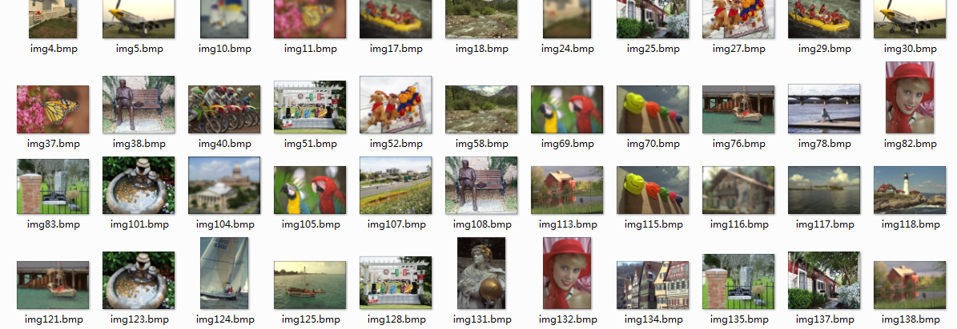
Introduction
Index
Method
JNB
Simulation results (Matlab)
Output:
PLCC=0.9477
SROCC=0.9301
RMSE=0.4133
MAE=0.3428
OR=0.34

Slide 23
Introduction
Index
Method
CPBD
Cumulative Probability of Blur Detection 模糊检测累加概率
基于边缘分析方法的图像模糊度评价
Output: PLCC SROCC OR RMSE MAE
将图像分为图像子块，将所有子块分为边缘快和平滑块，计算边缘块的边缘展宽和亮度对比度，结合JNB得到模糊度估计，最后统计累加概率得到模糊度。(见流程图)
The proposed metric correlates very well especially for images that have different background and foreground blur distortions or non-uniform saliency content.

Slide 24
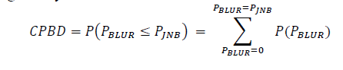
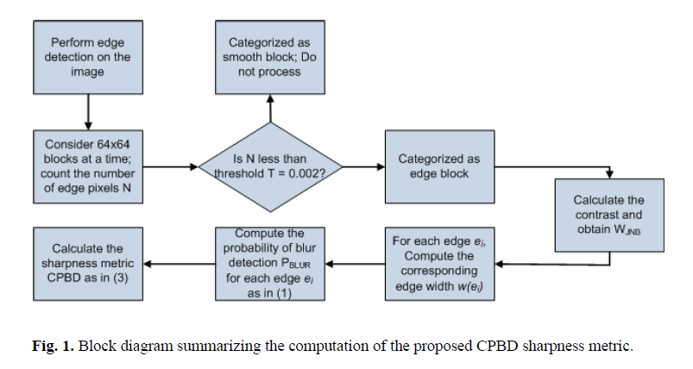
Introduction
Index
Method
CPBD

Slide 25
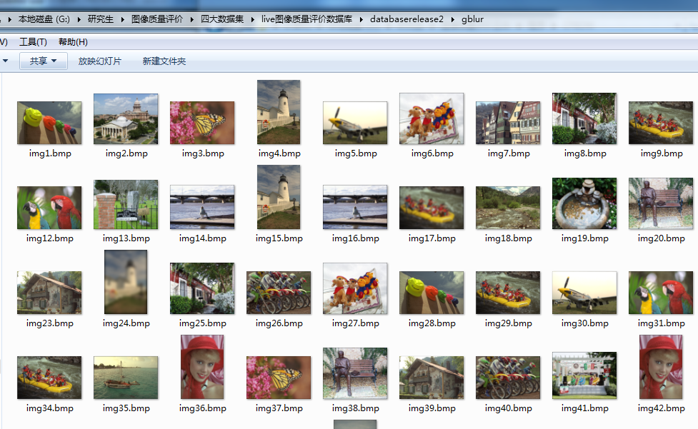
Introduction
Index
Method
CPBD
Simulation results (Matlab)
Output:
PLCC=0.9052
SROCC=0.9250
RMSE=7.2634
MAE=4.9850
OR=0.0805

Slide 26
Introduction
Index
Method
LPC
Local Phase Coherence 局部相位一致性
基于变换域方法的图像模糊度评价
Output：Sharpness Index (SI)
在复小波域计算局部相位一致性图，按照一致性越大权重越大的原则计算加权和，得到图像的整体锐利度指数
This approach decouples sharpness and blurriness assessment . Instead of associating sharpness reduction with a blurring process , the degradation of sharpness is identified as the loss of local phase coherence. This leads to novel sharpness measure that seems to respond to a much broader range of image distortion types.

Slide 27
Introduction
Index
Method
BRISQUE
Blind/ Referenceless Image Spatial Quality Evaluator 盲/无参考图像空域质量评价
基于支持向量机的方法 SVM+SVR (先用SVM进行失真类型识别，再对特定失真类型建立SVR回归分析模型)
基于空域统计特征
Output：quality score
自然图像归一化的亮度值趋向于单元正态高斯特性，而图像中的失真会改变归一化系数的统计特征，通过测量这种统计特征的改变，可以预测失真类型并评价图像质量。
先计算图像多尺度的去均值对比度归一化系数（MSCN），再对系数及其沿不同方向的相关系数进行非对称广义高斯拟合（AGGD）得到参数作为特征。
步骤：图像像素归一化、空域特征提取、图像质量计算

Slide 28
Introduction
Index
Method
BRISQUE
Simulation results (Matlab)
Quality score =4.7383
Quality score =68.9316
Quality score =45.7307

Slide 29
Introduction
Index
Method
Robust
Robust Statistical Approach 鲁棒性统计方法
基于BRISQUE、L-moments线性矩 （We modify BRISQUE using L-moment based parameter estimators to robustify the IQA model . L-moments are useful for robustly estimating the parameters of distributions.）
Robust statistical approaches have been applied to standard problems in image processing.But we are the first ones to explore their potential for image quality assessment applications.
Output：PLCC
Better correlation with human judgments of image quality are achieved when distortions deviate from natural scene statistics（NSS） models. Robust methods perform better when only small amount of training data is available for learning the framework.
Notes:
例如：局部图片滤波，图像重建，模糊分类，用到鲁棒性的图像去噪。

Slide 30
Introduction
Index
Method
SSEQ
Spatial and Spectral Entropies 基于空间熵和谱熵
Spatial entropy is a function of the probability distribution of the local pixel values. Spectral entropy is a function of the probability distribution of the local DCT coefficient values.
SVM+SVR
Output：Quality Score
Our model utilizes downsampled responses as inputs, then extracts a 12-dimensional local entropy feature vector (f1-f6 are spatial entropy features,f7-f12 are spectral entropy features) from the distorted image to be tested and learns to predict image quality scores from these features.
Notes:
空间熵：局部像素值的概率分布函数 // 谱熵：局部DCT系数值的概率分布函数

Slide 31
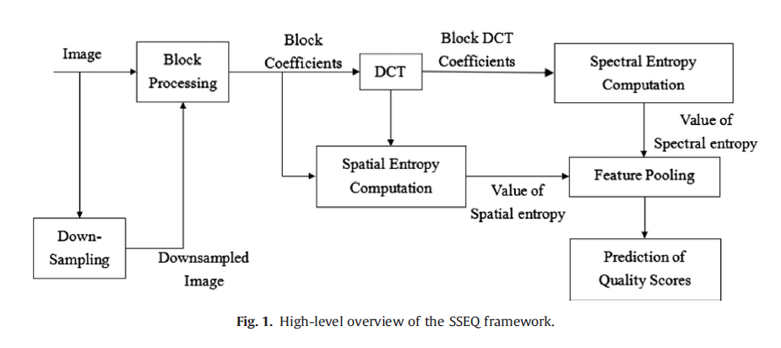
Introduction
Index
Method
SSEQ

Slide 32
Introduction
Index
Method
Opinion-aware (OA) IQA
Opinion-unaware （OU） IQA
OA-IQA approaches require a dataset comprising distorted images and associated subjective scores.
At the training stage, feature vectors are extracted from images and then the regression model, mapping the feature vectors to the subjective scores.
At the testing stage, a feature vector is extracted from the test image, and its quality score can be predicted by inputting the feature vector to the learned regression model.

Slide 33
Introduction
Index
Method
OA-IQA
Weaknesses of OA approaches
1 很难收集到一个训练样本集，包含了所有失真类型（包括各种类型之间的结合）的图片。
2 如果训练样本集图片是一种失真类型的，如果将训练好的模型运用到判定其他失真类型的图片时，结果会不是很精确。
3 目前opinion-aware的算法都是通过某一个现有数据库训练得到的，如果将其运用到其他数据库，或者判定一些真实世界中的失真图片，那么该算法的性能会大大降低。

Slide 34
Introduction
Index
Method
OU-IQA
These approaches DONOT require a dataset comprising distorted images and associated subjective scores
Offline learning stage: constructing a collection of quality-aware features from pristine images and fitting them to a multivariate Gaussian model M
Testing stage: the quality of a test image is expressed as the distance between a MVG fit of its features and M

Slide 35
Introduction
Index
Method
NIQE
Natural Image Quality Evaluator 自然图像质量评价
基于概率模型的方法
NIQE 提取了与BRISQUE 类似的图像特征，突破在于，训练回归模型时，不再需要图像的主观评价分数（Opinion-Unaware），而是在原始图像库上提取图像特征，然后利用多元高斯（MVG）模型进行建模。
基于人眼对图像中对比度较高区域更敏感的特征，提出在图像中选取显著区域建立特征模型的方法。
在计算其局部MSCN归一化图像后，选择部分图像块作为训练数据，以广义高斯模型拟合得到模型参数作为特征，采用多变量高斯模型描述这些特征。
“Distance”：between待评价图像特征模型参数and预先建立的模型参数
“Distance”：between the quality aware NSS feature model and the MVG fit to the features extrated from the distorted image.

Slide 36
Introduction
Index
Method
IL-NIQE
Integrated-Local NIQE 局部整合的自然图像质量评价
基于概率模型的方法
基于NIQE的改进方法
Output：SROCC LCC
与NIQE相比：1、增加了3种NSS特征共5种； 2、NIQE的一张测试图片用一个MVG模型，而IL-NIQE的每个图像块都用一个MVG描述
训练：用原始图像中的5种NSS特征建立MVG模型作为参考 测试： 将所有图像块的质量分数平均来得到总的质量分数

Slide 37
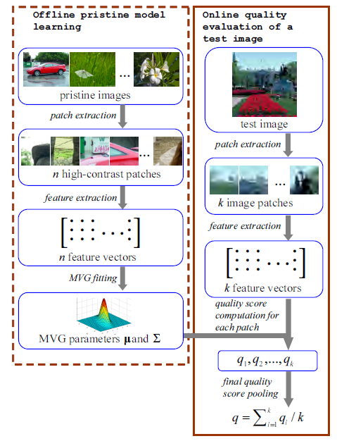
Introduction
Index
Method
IL-NIQE
Flowchart of IL-NIQE

Slide 38
Introduction
Index
Method
Introduction
Index
Method
线下原始图像学习阶段：
1、首先将一幅原始图像划分成P*P的patches
2、通过局部方差选择高对比度的PATCH
3、对每一个已经选择了的PATCH,提取特征向量，得到一个特征向量集。其中M是patch的个数，d是特征向量维数
4、用主成分分析法（PCA）进行了维数缩减，其中
5、
将 放入到多元高斯模型中训练，将其得到的模型作为原始模型
原始模型的平均向量为V1，协方差矩阵为

Slide 39
Introduction
Index
Method
Introduction
Index
Method
测试阶段
1、将测试图像分成P*P的patch
2、提取特征向量
3、缩减维数
4、训练得到一个新的多变量高斯模型， 是协方差矩阵
5、第i个patch的图片质量如下
6、整个图片的质量

Slide 40
Introduction
Index
Method
IL-NIQE
Simulation results (Matlab)
Quality score =6.9733
Quality score =63.2456
Quality score =55.2952

Slide 41
Introduction
Index
Method
CBIQ
Visual Codebook 视觉码本
基于码本的方法
SROCC LCC RMSE
通过纹理分析visual analysis、视觉码本、基于特征的Gabor filter，来获得图像的统计信息
This method is motivated by the observation that images with the same type of distortion and with similar quality share similar ”texture”.
Our method integrates the distortion classification into a general codebook framework. The NR-IQA is achieved by constructing a codebook using training images with all possible types of distortion.

Slide 42
Introduction
Index
Method
CBIQ
Assessment using a visual codebook
1、Codebook construction: The first stage consists of building a “codebook” of image patches which can be used to represent “quality information” .
具体步骤：（1）将图片分成B*B小块。（2）用Gabor filter提取特征，得到Gabor特征向量集合（3）用类似k-meas的聚类算法得到码本C
（4）码本C里的码字为C(i)，码字C(i)对应主管评价分数为DMOS(C(i))。
2、Image representation: Input images are represented by the distribution of codewords from the codebook obtained in the first stage.
H(i)为码字C(i)出现的概率
3、Nonlinear Mapping: we approximate DMOS using Qm by nonlinear regression using the following function

Slide 43
SUMMARY
Work to be done in the future

Slide 44
THANKS!

